Slide 1
TAXATION ISSUES ON DEMONETISATION
CA R. KRISHNAN FCA DISA

Slide 2
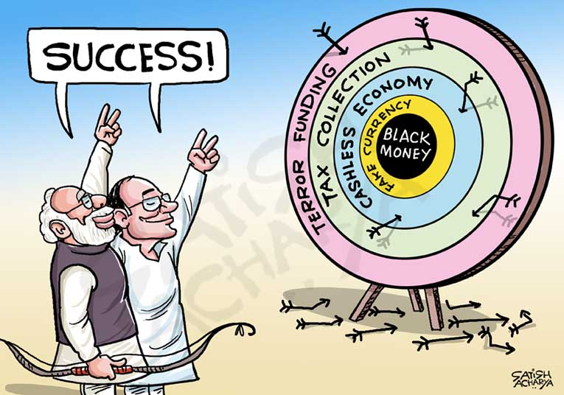
OBJECTS OF DEMONETISATION
To tackle black money in the economy.
To lower the cash circulation in the country which promotes corruption.
To weed out high value currency.
To check terror financing.
To promote digital transactions.

Slide 3
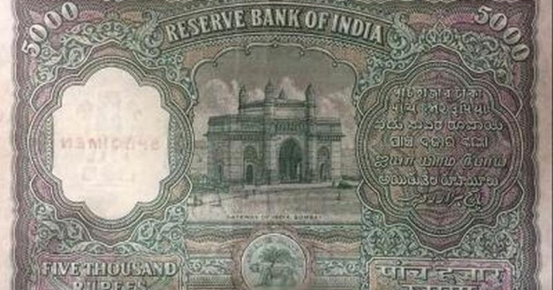
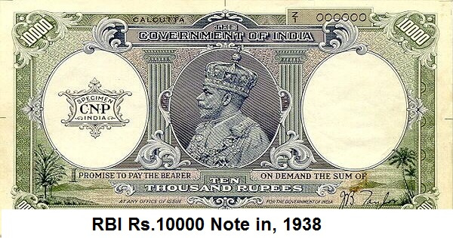
HISTORY OF EARLIER DEMONETISATION
First demonetisation in January 1946, when Rs.1,000/-, Rs.5,000/- and Rs.10,000/- notes were taken out of circulation.
Rs.10,000/- notes were the largest currency denomination ever printed by RBI, introduced in 1938.
All the three notes were reintroduced in 1954.
In 1970, Wancho Committee suggested demonetisation. But public outsmarted Govt. to get rid of high denomination notes.

Slide 4
HISTORY OF EARLIER DEMONETISATION
The Janata Govt. introduced The High Denomination Bank Notes (Demonetisation) Act on January 16, 1978, by which Rs.1,000/-, Rs.5,000/- and Rs.10,000/- notes were made illegal for the second time.
The present demonetisation is the third in the history of the country.

Slide 5
CASH DEPOSIT IN BANK ACCOUNT.
Taxing provisions:
Section 68 - Cash credit
Section 69 - Unexplained Investments Section 69A - Unexplained Money etc.
Section 69B - Investments etc. not fully disclosed

Slide 6
SECTION 68- CASH CREDIT

Slide 7
INGREDIENTS OF SECTION 68:
Any sum found credited in the books of an assessee
Assessee offers no explanation about the nature & source thereof, or
Explanation offered is not satisfactory in the opinion of the AO
Consequences:
The sum so credited may be charged as income of the assessee for that P.Y. (year in which it is found credited)

Slide 8
ONUS LIES ON ASSESSEE TO PROVE THE FOLLOWING:
The identity of the creditor is established;
The capacity/creditworthiness of the creditor is beyond doubt;
The transaction is genuine.
Once an assessee proves the identity, creditworthiness and genuineness of the creditor, the onus shifts on the AO

Slide 9
AO TO CONDUCT PROPER ENQUIRIES
BEFORE MAKING ANY ADDITION…
CIT Vs. United Commercial and Industrial Co. (Pvt.) Ltd. (1991) 187 ITR 596 (Cal)
CIT vs. Precision Finance Pvt. Ltd. (1994) 208 ITR 465 (Cal)
Korlay Trading Co.,. Ltd. (1998) 232 ITR 820 (Cal).
Kamal Motors v. CIT [2003] 131 Taxman 155 (Raj.).
CIT v. R.S. Rathore [1995] 212 ITR 390 (Raj.),
Life Insurance Corporation of India vs. CIT (1996) 219 ITR 410 (SC)
CIT vs. Metachem Industries (2000) 245 ITR 160 (MP)
CIT vs. Oasis Hospitalities Pvt. Ltd., 333 ITR 119 (Delhi)(2011).

Slide 10
SOURCE OF SOURCE NEED NOT BE PROVED BY THE ASSESSEE:
DCIT v Rohini Builders (2002) 256 ITR 360 (Guj)
Hastimal v. CIT 49 ITR 273 (Mad.)
Tolaram Daga v. CIT 59 ITR 632 (Assam)
Nemichand kothari v. CIT 264 ITR 254 (Gau.)
Murlidhar Lahorimal v. CIT 280 ITR 512 (Guj.)
Exception :
Proviso to Section 68

Slide 11
SECTION 69 UNEXPLAINED INVESTMENTS

Slide 12
INGREDIENTS OF SECTION 69
There should have been investments made by assessee
Such Investments are not recorded in books of
Accounts (if any)
assessee offers no explanation about the nature and
source of the investments, or
explanation offered by him is not satisfactory, in the opinion of the Assessing Officer.
Consequences:
The value of the investments may be deemed to be the income of the assessee of such financial year (year in which investment are made)

Slide 13
SECTION 69A- UNEXPLAINED MONEY, ETC.

Slide 14
INGREDIENTS OF SEC. 69A
Assessee found to be owner of any money, bullion, jewellery or other valuable article,
Such assets are not recorded in books of accounts(if any)
The assessee offers no explanation about the nature and
source of acquisition or
Explanation offered is not Satisfactory in the opinion of AO
Consequences:
The value of the such asset may be deemed to be the income of the assessee of such financial.

Slide 15
SECTION 69B- AMOUNT OF INVESTMENTS, ETC. NOT FULLY DISCLOSED IN BOOKS OF ACCOUNTS

Slide 16
INGREDIENTS OF SEC. 69B
This section is similar to Section 69 & Section 69A.
As per this section, if assessee is found to be owner of any investment, bullion, jewellery or other valuable article in excess of what has been disclosed in Books of Accounts, then such excess value of the specified assets will be deemed as income of the assessee
16

Slide 17
SECTION 69C- UNEXPLAINED EXPENDITURE, ETC.

Slide 18
INGREDIENTS OF SECTION 69C
Assessee has incurred expenditure
Assessee offers no explanation about the source of such expenditure (Or part thereof), or
Explanation offered by him is not satisfactory in the opinion of AO
Consequences:
Such unexplained expenditure shall be deemed to be income of assessee.
Such unexplained expenditure shall not be allowed as a deduction under any head of income.

Slide 19
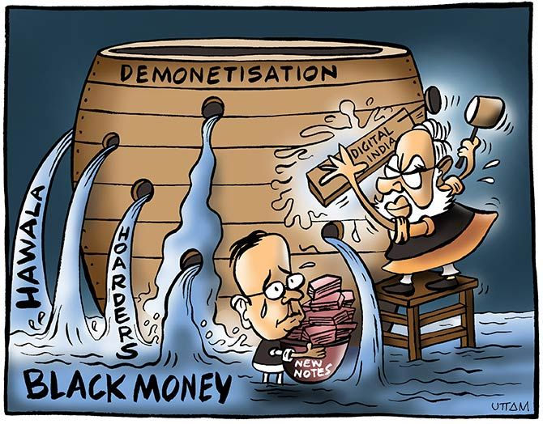
IMPACT OF DEMONETISATION

Slide 20
STATUTORY DISCLOSURES

Slide 21
DISCLOSURES REQUIRED UNDER THE COMPANIES ACT, 2013
Notification No. G.S.R. 308(E) dated 30th March 2017 issued by MCA required the companies to disclose the Details of Specified Bank Notes (SBN) held and transacted during the period from 8th November, 2016 to 30th December, 2016 .
Notification No. G.S.R. 307(E) dated 30th March 2017 issued by MCA required the auditor to incorporate in its audit report the following :
“(d) whether the company had provided requisite disclosures in its financial statements as to holdings as well as dealings in Specified Bank Notes during the period from 8th November, 2016 to 30th December, 2016 and if so, whether these are in accordance with the books of accounts maintained by the company.”

Slide 22
DISCLOSURES REQUIRED IN ITRs
Disclosure of cash deposited during the period was required to be made in the ITR forms if the cash deposited was Rs.200,000 or more.

Slide 23
Rule 114E: Furnishing of Statement of Financial Transaction
(inserted w.e.f. 15.11.2016)
Sl No. | Nature and Value of Transaction | Reporting person
i. | Cash deposit during the period 09.11.16 to 30.12.16 aggregating to-
 | (i) Twelve lakh fifty thousand rupees or more, in one or more current account of a person; or | i.) A banking company or a co- operative bank to which the Banking Regulation Act, 1949 applies; ii.)Post Master General as reffered to in clause (j) of Section 2 of the Indian Post Office Act, 1898
 | (ii)Two lakh fifty thousand rupees or more, in one or more accounts(other than a current account) of a person.
ii. | Cash deposits during the period 01.04.16 to 09.11.16 in respect of accounts that are reportable under Sr. No. 12 | i.) A banking company or a co- operative bank to which the Banking Regulation Act, 1949 applies; ii.)Post Master General as reffered to in clause (j) of Section 2 of the Indian Post Office Act, 1898₂₁

Slide 24
AMENDMENTS IN THE ACT

Slide 25
THE TAXATION LAWS (SECOND AMENDMENT) ACT,2016
Statement of Objects & Reasons by Finance Minister Arun Jaitley on 26thNovember, 2016 :
Evasion of taxes deprives the nation of critical resources which could enable the Government to undertake anti-poverty and development programmes. It also puts a disproportionate burden on the honest taxpayers who have to bear the brunt of higher taxes to make up for the revenue leakage. As a step forward to curb black money, bank notes of existing series of denomination of the value of five hundred rupees and one thousand rupees (hereinafter referred to as specified bank notes) issued by the Reserve Bank of India have been ceased to be legal tender with effect from the 9th November, 2016.
Concerns have been raised that some of the existing provisions of the Income-tax Act, 1961 could possibly be used for concealing black money. It is, therefore, important that the Government amends the Act to plug these loopholes as early as possible so as to prevent misuse of the provisions. The Taxation Laws (Second Amendment) Bill, 2016, proposes to make some changes in the Act to ensure that defaulting assessees are subjected to tax at a higher rate and stringent

Slide 26
SECTION 115BBE- TAXATION OF DEEMED INCOME U/S. 68-69D

Slide 27
TAXATION
The Taxation Laws (Second Amendment) Act, 2016
Tax on income referred to in section 68, 69, 69A, 69B, 69C or 69D whether included in ROI or added by AO – tax rate 60% (from 30%)
Finance Act 2017 provides for a surcharge on such income at 25% of tax.
Effective rate becomes 75.00% + Cess( upto AY 2018-19 – 3%)
( from AY 2019-20 - 4%)

Slide 28
TAXATION
Amendment to Section 115BBE by The Taxation Laws (Second Amendment) Act, 2016
Whether applicable for entire F.Y. 2016-17?
Legislations which modified accrued rights or which impose obligations or impose new duties or attach a new disability have to be treated as prospective unless the legislative intent is clearly to give the enactment a retrospective effect; unless the legislation is for purpose of supplying an obvious omission in a former legislation or to explain a former legislation.
-CIT v. Vatika Township (P.) Ltd. [2014] 367 ITR 466 (SC).

Slide 29
Assurances given by Officials
Immediately after demonetisation, an assurance was given by the Government that cash deposit upto Rs. 2,50,000/- shall not be inquired in the cases of small businessman, housewives, artist, labour, etc. through advertisements and media.
Thereafter, Hon’ble Prime minister on 12/11/2016 made a public announcement that deposit of notes upto Rs. 2,50,000/- made by married woman will not be subject to any sort of inquiries. But, no official circular was issued in this regard.
Representation was made by CTC vide representation dated 14/11/2016 requesting to clarify this issue by way of Circular.
No Circular is issued clarifying the same.
Instead we have amendment which does not have any threshold limit. Even small amount of Rs. 50,000/- can be covered u/s 115 BBE.
7

Slide 30
SET OFF OF LOSS AGAINST INCOME DEEMED u/s. 68-69D
Allowed:
CIT v. Chensing Ventures [2007] 291 ITR 258 (Chennai)
CIT v. Shilpa Dyeing & Printing Mills (P.) Ltd [2013] 219 Taxman 279(Guj.)
Vijaya Hospitality & Resorts Limited vs. CIT(Ker.) ITA No.20 of 2019
Not Allowed:
Kim Pharma (P) Ltd v. CIT [2013] 258 CTR 454 (P&H) relying on Fakir Mohmed Haji Hasan v. CIT [2001] 247 ITR 290 (Guj.)
CBDT Circular No. 11/2019 dt. 19/06/2019:
Para 4 of the said circular CBDT have clarified that assessee is entitled to claim set-off of loss against income determined u/s. 115BBE till AY
2016-17
From AY 2017-18- Section 115BBE amended.
No set off of loss or allowance against deemed income u/s 68, 69, 69A, 69B or 69C.

Slide 31
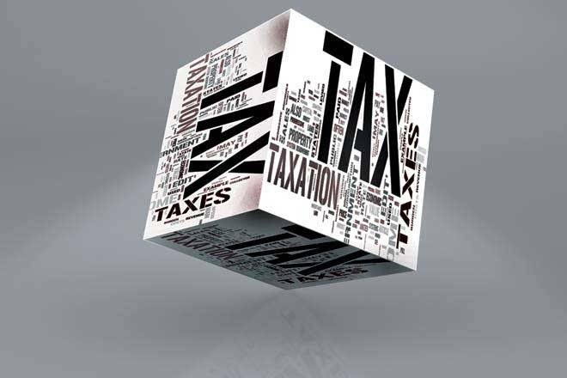
OTHER TAX IMPLICATIONS
The following would also be other implications of deemed
income u/s. 68-69D:
no deduction in respect of any expenditure,
no deduction in respect of any allowance,
no set-off of any losses, against such deemed income
-Section 115BBE(2)

Slide 32
NOTIFICATION F.NO. 225/391/2017 DATED 24-11-2017
CBDT issues directions for scrutiny assessment in case of revised
ITRs filed post DEMONETISATION
Revision of Income-tax return (ITR) is allowed only if any omission or wrong statement is noticed therein by the assessee. Such omission or wrong statement may have occurred due to a bonafide and inadvertent error or a mistake on the part of assessee.
However, post DEMONETISATION period, it was found that some of the assessees tried to build an explanation for cash deposits in their bank accounts by manipulating their books of accounts and filing revised or belated ITRs.
Filing revised or belated ITRs just to build an explanation for cash deposits in bank account becomes questionable and, therefore, the transaction disclosed in it which are over and above the original return are liable to be taxed under anti-abuse provisions of the Income-tax Act.

Slide 33
PENAL PROVISIONS

Slide 34
SECTION 271AAC

Slide 35
SECTION 271AAC
Penalty is leviable if:
The total Income determined of the Assessee includes any income referred to in Section 68, 69, 69A, 69B, 69C & 69D
And B)
The said Income has not been included in the Return of Income furnished u/s 139
Or
Tax on the said Income is not paid on or before the end of the relevant previous year in accordance with provisions of section 115BBE (1) (i)
Amount of penalty – 10% of tax payable as per provisions of
section 115 BBE (1)(i) .

Slide 36
SECTION 271AAC
No penalty u/s 270A due to under reporting of income shall be imposed in respect of the income on which penalty can be levied u/s 271 AAC.
Penalty imposable u/s 271 AAB due to search being conducted u/s 132, simultaneous penalty can be levied u/s 271 AAC.
Provisions of Section 274, dealing with ‘Procedure for levy of penalty’ and section 275, dealing with Bar of limitation for imposing penalty are applicable
Order levying penalty u/s 271 AAC is appealable before C.I.T. (A), because 271 AAC is covered under chapter XXI which is covered u/s 246 A(1) (q).
Section 273A : Power to reduce or waive penalty, etc., in certain cases Section 270A is covered, however section271AAC is not covered.

Slide 37
SECTION 271AAB

Slide 38
AMENDMENT IN SECTION 271AAB
BEFORE 15.12.2016 | AFTER 15.12.2016
A sum computed @ 10% of the undisclosed income of the specified previous year in case assessee admits the undisclosed income in statement u/s 132(4) | A sum computed @ 30% of the undisclosed income of the specified previous year in case assesse admits the undisclosed income in statement u/s 132(4)
A sum computed @ 20% of the undisclosed income of the specified previous year in case assessee does not admit the undisclosed income in statement u/s 132(4) but admits in the ROI
A sum computed @ 60% of the undisclosed income if not covered in the provisions of clause (a) & (b) | A sum computed @ 60% of the undisclosed income if not covered in the above provisions

Slide 39
JUDICIAL PRECEDENTS

Slide 40
ONUS OF PROOF
Onus is on assessee to prove positively the source and nature of an amount received by him in accounting year, and if he fails to discharge that onus, income-tax authorities are entitled to draw an inference that amount received was of an income nature.
Where assessee not having satisfactorily proved source and nature of amount which he encashed on demonetisation, revenue authorities were perfectly justified in drawing an inference that said sum was of an income nature.
-Chunilal Rastogi vs. CIT [1955] 28 ITR 341 (Pat.)
-Anil Kumar Singh vs. CIT [1972] 84 ITR 307 (Cal.)
-M. L. Tewary vs. CIT [1955] 27 ITR 630 (PAT.)

Slide 41
ONUS OF PROOF
Cash in hand in books:
Where amount en-cashed on DEMONETISATION was part of cash balance in the books of account, AO cannot disbelieve a part of such cash balance as being not of specified denominations, when the books are not rejected.
-Lalchand Bhagat Ambica Ram vs. CIT [1959] 37 ITR 288(SC).
Affidavit of payers:
When assessee submitted books of account showing relevant entries showing payment being made to them which resulted in cash in its books and also submitted affidavits of payers, Revenue authorities cannot hold that it was not possible that all payments after a particular date were being made in multiples of Rs. 1000. No addition can be sustained based on pure surmise.
- Mehta Parikh & Co. v. CIT [1956] 30 ITR 181 (SC).

Slide 42
ONUS OF PROOF
Adhoc Bifurcation of cash between different denominations:
Where there was sufficient balance on date of deposit, Assessing Officer cannot make additions of part of amount for want of details of receipts of some of high denomination notes. There was no justification for adding a portion of amount tendered by assessee for encashment of high denomination notes as income of assessee from undisclosed sources for alleged failure of assessee to furnish source of acquisition of amount in such notes.
-Narendra G. Goradia vs. CIT [1998] 234 ITR 571 (Bombay)
-Lakshmi Rice Mills vs. CIT [1974] 97 ITR 258 (Pat.)

Slide 43
ONUS OF PROOF
Cash in hand – denomination of notes
It was possible that even in a cash balance of a very large amount there may be no high denomination notes at all. Equally it was possible that even , in a cash balance of a small amount almost the entire cash balance may be made up only of high denomination notes.
When both the possibilities were there, it could not be said that those or any of them represented the income of the assessee from some undisclosed source.
-Gur Prasad Hari Das vs. CIT [1963] 47 ITR 634 (All.)

Slide 44
ONUS OF PROOF
Logical to keep cash in high denomination notes:
If the cash balance of the assessee-company was steadily increasing it would not be at all unreasonable to accept the explanation given by the assessee-company that, for the sake of convenience, the cash balance was being kept in high denomination currency notes.
High denomination currency notes could be stored more easily and, at the time of accounting, they would have facilitated counting. Since the balance was increasing steadily, the assessee might not have felt it necessary to keep the balance in currency notes of low denomination .
Such an explanation by assessee is not an unreasonable explanation.
- Kanpur Steel Co. Ltd. v. CIT [1957] 32 ITR 56 (ALL.)

Slide 45
ONUS OF PROOF
No books: Cash from past savings:
Where the assessee did not maintain accounts and hence did not produce any Home Chest Account though it was his case that the high denomination notes were savings from his personal allowance, there was no warrant for drawing an adverse inference.
Assessee produced details of withdrawals for past 7 years, and claimed the amount encashed on DEMONETISATION as to be out of savings from such withdrawals, such an explanation can not be rejected by AO.
-Sri Nilkantha Narayan Singh vs. CIT [1951] 20 ITR 8
(Pat.)

Slide 46
Pass book supplied by the bank is not books maintained by the assessee and hence addition can not be made u/s 68 in respect of credits in such pass book.
CIT v. Bhaichand N. Gandhi [1982] 141 ITR 67 (Bom.)
Smt. Manasi Mahendra Pitkar v. ITO [2016] 160 ITD 605 (Mumbai - Trib.)
Where in respect of huge amount of cash deposited in bank, assessee failed to give list of persons who advanced cash to him along with their confirmation in respect of said cash credits, Assessing Officer was justified in adding said amount to assessee's taxable income under section 68.
Sudhir Kumar Sharma (HUF) v. CIT [2014] 46 taxmann.com 340 (Punjab & Haryana)

Slide 47
BOOKS NOT MAINTAINED
Though section 68 of the Act may not be strictly applicable since the assessee was not maintaining any books of account and the bank statement cannot be considered as the assessee’s books of account, on the basis of the judgment of the Supreme Court in the case of A. Govindarajulu Mudaliar v. CIT [1958] 34 ITR 807, it is the onus of the assessee to explain the cash received by him and if there is no explanation or acceptable evidence to prove the nature and source of the receipt, the amount may be added as the assessee’s income on general principles and it is not necessary to invoke section 68, nor is it necessary for the income-tax authorities to point out the source of the monies received. Even if section 68 is not applicable, the cash deposit in the bank can be asked to be explained by the assessee under section 69 or section 69B of Act.
[Manoj Aggarwal v. DCIT [2008] 113 ITD 377 (DELHI) (SB)]

Slide 48
AMOUNT SEIZED AFTER THE CUT OFF DATE ?
Whether ‘money’ for the purpose of Section 69A?
The expression ‘money’ has different shades of meaning. In the context of income-tax provisions, it can only be a currency token, bank notes or other circulating medium in general use, which has the representative value. Therefore, the currency notes on the day when they were found to be in possession of the assessee should have had the representative value, namely, it could be tendered as a money, which has intrinsic value. When, the RBI refused to exchange the high denomination notes when they were tendered for exchange, they were only scrap of paper and they could not be used as circulating medium in general use as the representative value and, therefore, it could not be said that the assessee was in possession of unexplained money.
CIT vs. Andhra Pradesh Yarn Combines (P.) Ltd. [2006]
282 ITR 490 (Karnataka).

Slide 49
BUSINESS RECEIPTS
Amount credited in business books can normally be presumed as business receipt.
When an amount is credited in business books, it is not an unreasonable inference to draw that it is a receipt from business,
if the explanation given by the assessee as to how the amounts came to be received is rejected by all the income- tax authorities as untenable
Lakhmichand Baijnath V. Cit [1959] 35 Itr 416 (Sc).

Slide 50
IT DEPARTMENT CHECKLIST TO TRACE UNACCOUNTED DEMONETISATION CASH
Salient Features of Check List
All Unaccounted Cash Deposits made between 9th Nov, 2016 and 31st Dec, 2016 to be examined
If tax paid disputes amount has to be checked with the bank
Return filing Compliance
TI of Tax payer in 2016-17
GTI including exempt income of taxpayer in FY 2016-17
% of tax deposit to GTI ( including exempt income)

Slide 51
Salient Features of Check List
AO to look into the nature of deposit after assessing the explanation provided by the tax payer
Vis a viz quantum of unaccounted deposit according to AO
Verification check point include whether quarterly VAT Return is revised in the post demonetisation period
If small part of cash is deposited in or withdrawn from the bank despite having huge cash in hand.

Slide 52
Salient Features of Check List
If there is large change in the purchases and sales figures betweeen original &n revised returns, the changes are for genuine reasns
Assessemnt procedure as per check list include – if books rejected and if additions made under 68 to 69D, whether tax is calculated as per section 115BBE& whether penalty u/s 271AAC have been levied
To examine monthly cash sales and cash deposits from the period April 2016 to Nov 8, 2016

Slide 53
Different Scenarios that could arise in tax assessments
No books of accounts to explain cash deposited in banks
Books of accounts available, but no sufficient cash balance in the books to explain the cash deposits
Carrying of high cash balance in the books of accounts consistently
Increased cash balance prior to deposit of money in the bank

Slide 54
Different Scenarios that could arise in tax assessments
Admission of having transacted in demonetisation notes post 8.11.2016
Claim of unusual exempted income like agriculture income to explain deposits
Past saving, Sale of Assets already declared in ITR available as cash balance, Gifts from relatives who has sources etc.,
Unusual increase in sales for which VAT Returns have been filed
VAT return pending for October 2016 filed originally showing increased sales than usual

Slide 55
Different Scenarios that could arise in tax assessments
Income declared year after year under 44AD/no book maintained cases without books of accounts- whether availability can be claimed
Cash deposited by others in your account , where identity can also be established
AO threatening to intimate other agencies of the offence of dealing in demonetised notes, where assessee admits having dealt with banned notes.
Search, post demonetisation finds assessee in possession of demonetised
notes. Can Sec 69A be invoked in respect of those notes ?

Slide 56
IMPORTANT CASE LAWS RELATING TO TAXABILITY OF BLACK MONEY
Where ITAT accepted only 22 demonetised Rs.1,000/- notes as possibly available with the assessee out of 28 notes deposited, were there was sufficient cash balances, the high court held that finding of ITAT was based on surmises and conjectures and cannot be upheld.
-Madhuri Das Narain Das vs. CIT 671 ITR 368 (All)

Slide 57
IMPORTANT CASE LAWS RELATING TO TAXABILITY OF BLACK MONEY
Explanation of the assessee is found unsatisfactory
Assessee filed sworn statement that she won jackpot in horse races
AO and Settlement commission Discredited her version
Theory of human probabilities applied
- Sumati Dayal vs. CIT 214 ITR 801 (SC)

Slide 58
IMPORTANT CASE LAWS RELATING TO TAXABILITY OF BLACK MONEY
Search at assessee premises revealed that, assessee had purchased a property A.
Assessee explained that his company R had received cash of Rs. 1 Cr out of sale of another property G, which amount was utilized for purchasing A.
However buyer of G property denied having paid cash to company R.
AO held that purchases of A property remained unexplained and made addition accordingly.
On appeal addition was deleted on the ground that company R had declared capital gain including the cash proceeds of Rs.1 Cr

Slide 59
IMPORTANT CASE LAWS RELATING TO TAXABILITY OF BLACK MONEY
Hon’ble High court concurred with the appellate authoroties with their findings.
- CIT vs. Tilak Raj Anand 373 ITR 1 (Del)

Slide 60
IMPORTANT CASE LAWS RELATING TO TAXABILITY OF BLACK MONEY
Unexplained investment found during search
Cash shortage as per books of accounts, ITAT allowed set off to extend of cash shortage.
On appeal to High court , held that where undisclosed income remained unexplained by the assessee, there is no reason to give setoff on presumption that said amount would have gone towards unexplained investment
-CIT vs. Meriya Bankers Chits and Investment 232
Taxmann 117 (Ker)

Slide 61
IMPORTANT CASE LAWS RELATING TO TAXABILITY OF BLACK MONEY
Books of Accounts of Assessee accepted by revenue as genuine
Assessee not required to prove source of receipt of high denomination notes, which were legal tender at that time.
Where there is sufficient balance at hand to cover the value of high denomination notes subsequently demonetized and even more, in the absence of any finding that books of accounts are not genuine, the source is disclosed.
What has to be disclosed and established is the source of income/receipts of money, not the source of HD notes-AY 46-47
- Lakshmi Rice Mills Vs. CIT 97 ITR 258 (Pat HC)

Slide 62
IMPORTANT CASE LAWS RELATING TO TAXABILITY OF BLACK MONEY
Addition made to income u/s 69A for the reason the same was not recorded in the books of accounts and failed to offer explanation.
Penalty u/s 271(1)(c) was also levied.
Held that the Asseesee was found in possession of high denomination notes, which ceased to be legal tender and had no value in the market.
Addition u/s 69A itself is unsupportable. Question of levying penalty u/s 271(1)(c) cannot arise.
- CIT Vs. Andhra Pradesh Yarn Combines (P) Ltd. 282 ITR 490 ( Ker. Hc)

